Slide 1
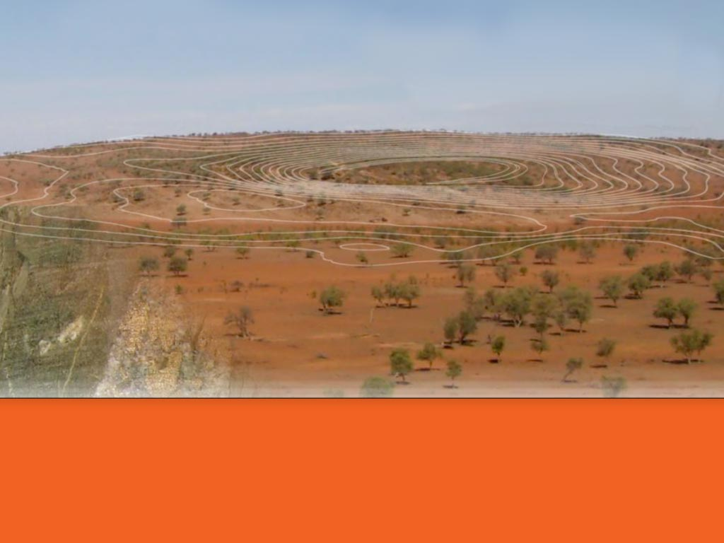

A new Intrusion-Related Gold field in the Thomson Fold Belt, NSW
Mines and Wines in Orange, September 2013

Slide 2
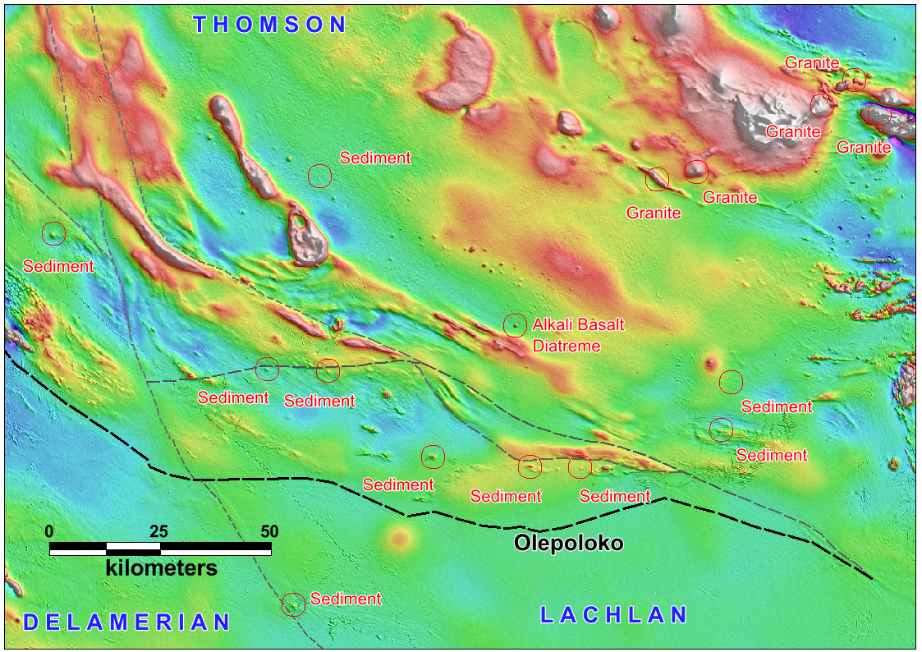


2
Thomson: small circular magnetic anomalies
Tongo Fault
Notes:
Drilling in NE area is by Meridian, Thomson and Pangaea

Slide 3
The Thomson Fold Belt in NSW
3
Under Cover
Magnetic anomalies in basement
Possible explanations for small circular magnetic anomalies
  Mafic igneous intrusions
  Felsic igneous intrusions
  Cobar-type orebodies
  Diatremes
  Other type of pyrrhotite body or magnetite lens or pipe
Not sediments though (usually linear anomalies)

Slide 4
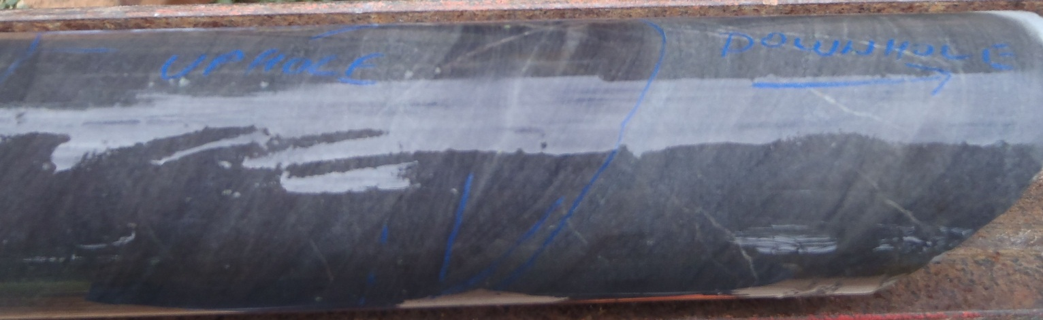
Sediments
4
Turbidites – sand/silt sequence
Zircon ages (F16, Cut B) – 501 Ma youngest with confidence; similar provenance to Amphitheatre Grp (Alley Sst – Glen et al 2010)
Steeply dipping and sometimes overturned
Moderate cleavage
Are they an extension of LFB as an Arc bend?
Age somewhere between NeoProterozoic and Mid Silurian

Slide 5
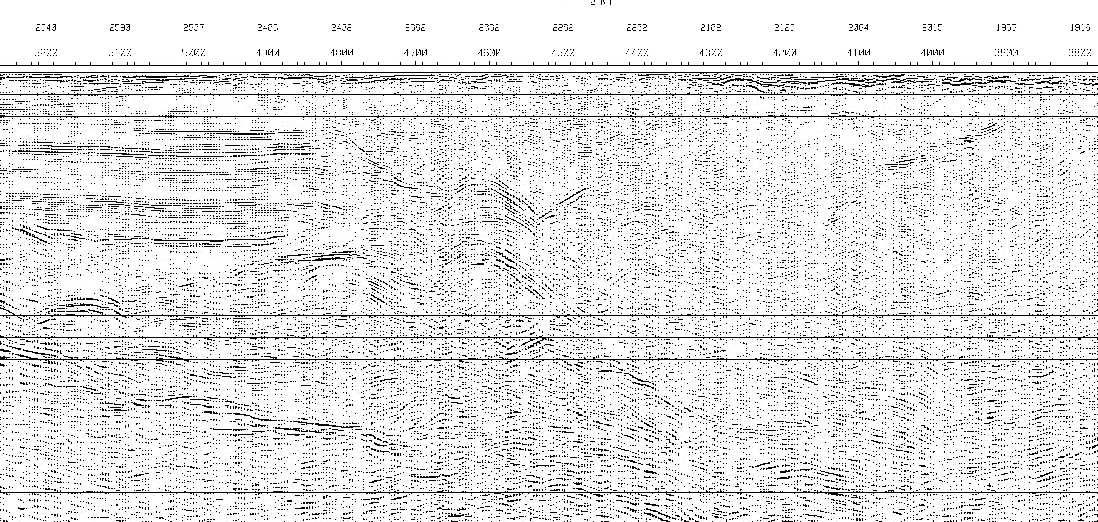
5
Seismic detail
North
Cuttaburra
Trend
Tongo Fault
Late Devonian Basin
Thomson Fold Belt
Olepoloko Fault
Notes:
Section is about about 30km along Line TL2

Slide 6
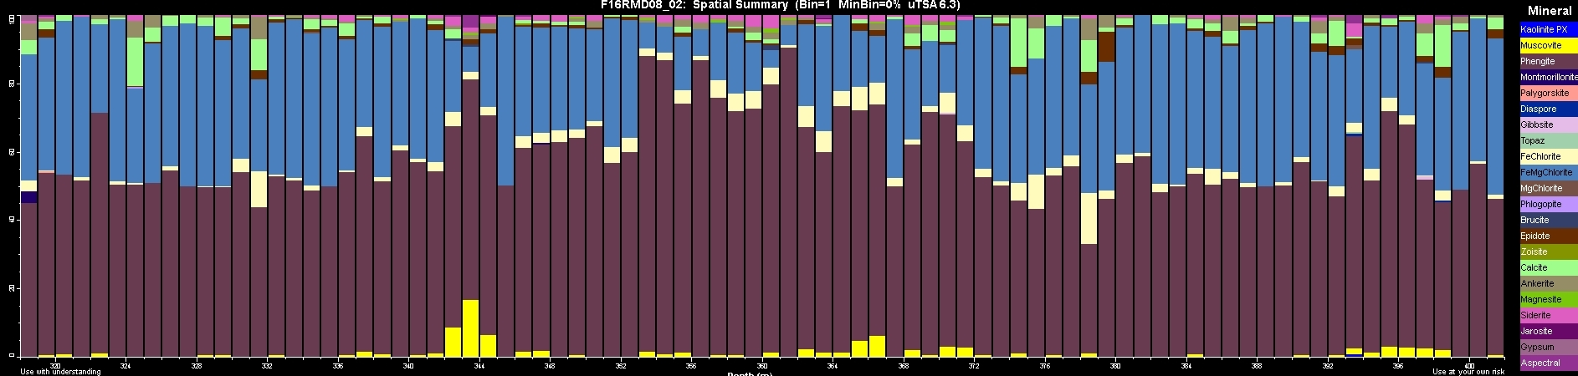
6
Thomson Alteration Style
F16 drill hole Hylogger Log – showing zones of Cobar-style alteration
Along with pyrrhotite veining, anomalous Zn 2,400ppm, Pb 362ppm, Cu 690ppm
Siderite, Ankerite, Calcite
Muscovite

Slide 7
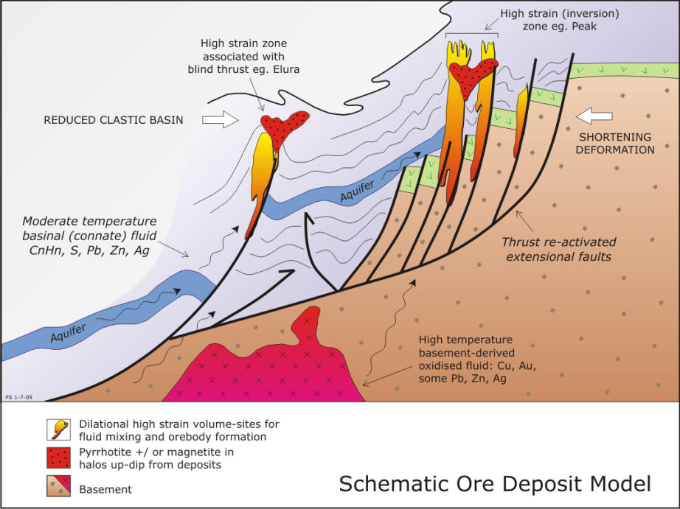
7
COBAR DEPOSIT MODEL
Is this model applicable?
Rocks – marine sediments
Steeply plunging pipe-like deposits on basin margin faults
Compressional tectonics on basin margin
Well defined alteration haloes of chlorite/quartz/sericite ± ankerite,
Broad, but subtle geochemistry (inc. As, W) away from mineralisation, and
Broad iron sulphide aureoles genetically linked to economic ore deposits.

Slide 8
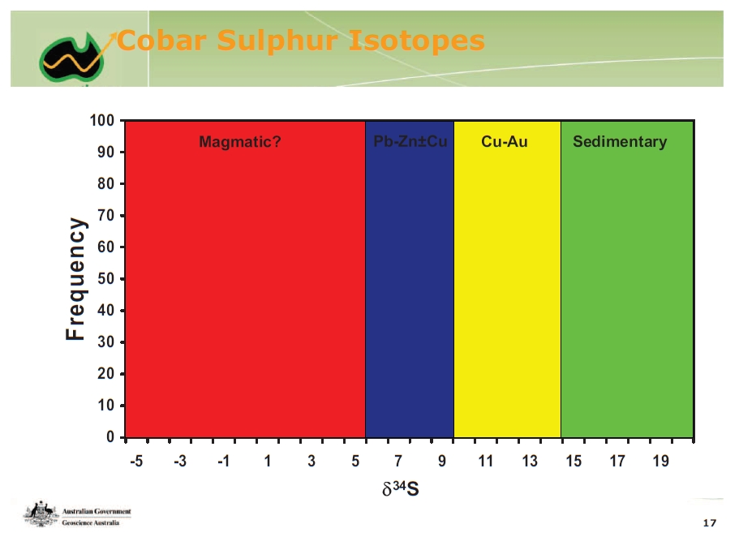
8
Thomson Isotopic Analysis
Cuttaburra pyrite and pyrrhotite,
F16 pyrite and galena

Slide 9
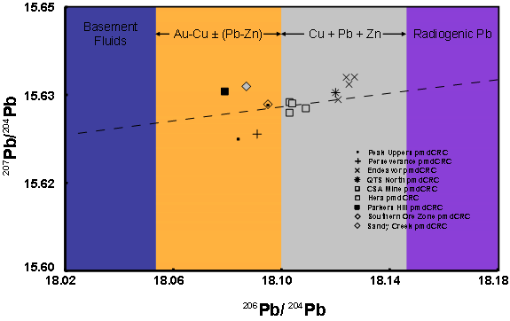
9
Thomson Isotopic Analysis
  Galena from drill holes at Cut B, Cut Ac, F14 and F16
Cut Ac
F14
Cut B
F16

Slide 10
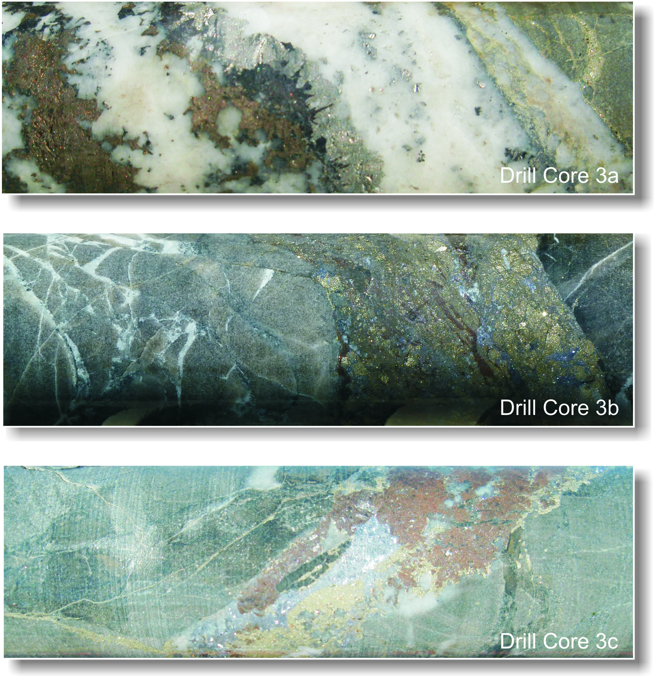

10
Cuttaburra – altered sediments
Hydrothermal alteration systems - eight systems so far with just 13 effective drill holes
Similar veining, alteration and mineralisation - Metal suite – Au-W-Sn-Cu-Pb-Zn-As-Bi-Mo
“Ore grade” material found for the first time in 2011 (but deep at 400m)
High grades of up to 3.7 g/t gold, 4% zinc, 113 g/t silver, 0.5% copper, 0.8% tin, 0.6% tungsten, 0.9% lead in veins

Slide 11
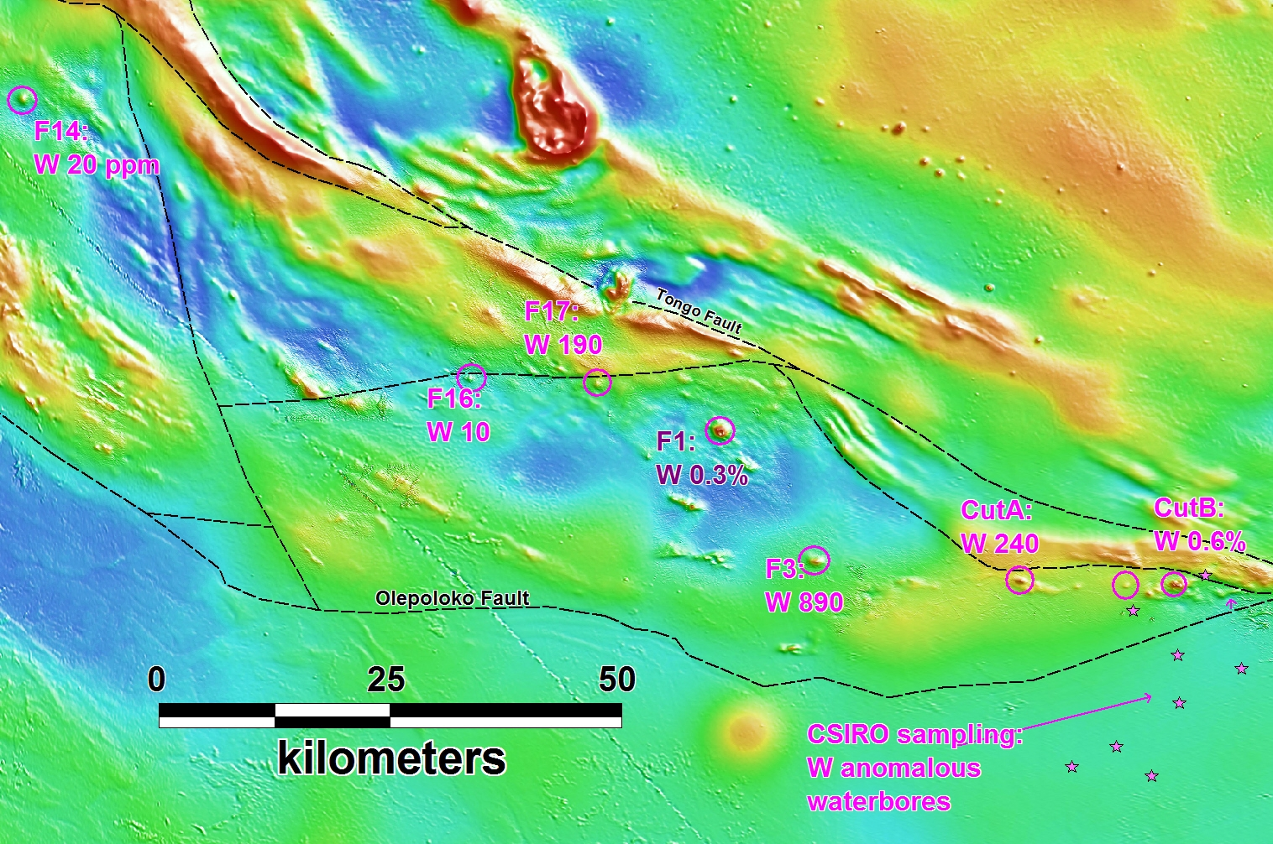
11
Tungsten - a geochemical pathfinder

Slide 12
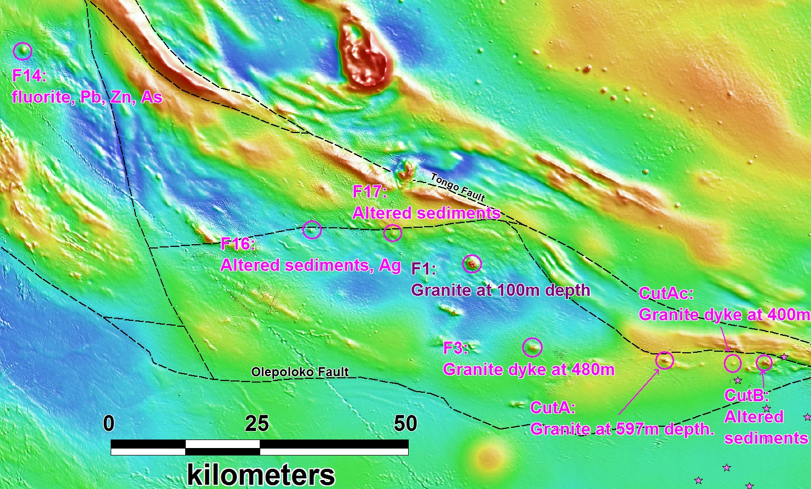
12
Tungsten + Granite – New Model Needed
Felsic intrusions

Slide 13
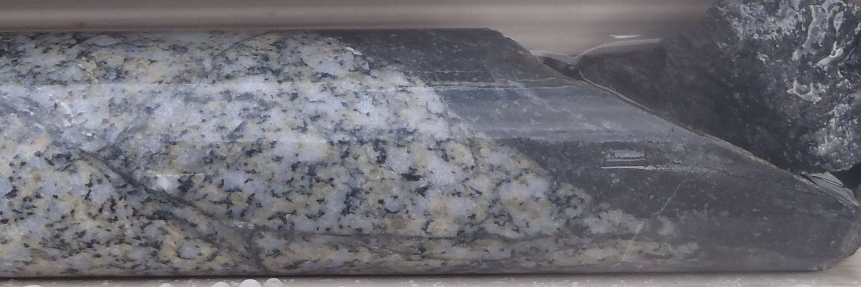
Intrusions
13
CutA- Biotite granodiorite* – 428.3 +/- 2.8 Ma (E Chisholm, GA 2012).
I-type (mildly reduced, slightly peraluminous, “contaminated I-type” character – P Blevin)
Multiple intrusions over 150 km; ?Stitches LFB and ?TFB
S-type granitoids in adjacent Girilambone Group but more typically Sn-W– eg Wilgaroon
*35% quartz, 36% plagioclase, 15% orthoclase, 8% mostly altered biotite, 5-6% muscovite and <1% each of scheelite and pyrrhotite (inc. cp, py, sp).
Notes:
Photo is granite contact at CutAD01 597m downhole.

Slide 14
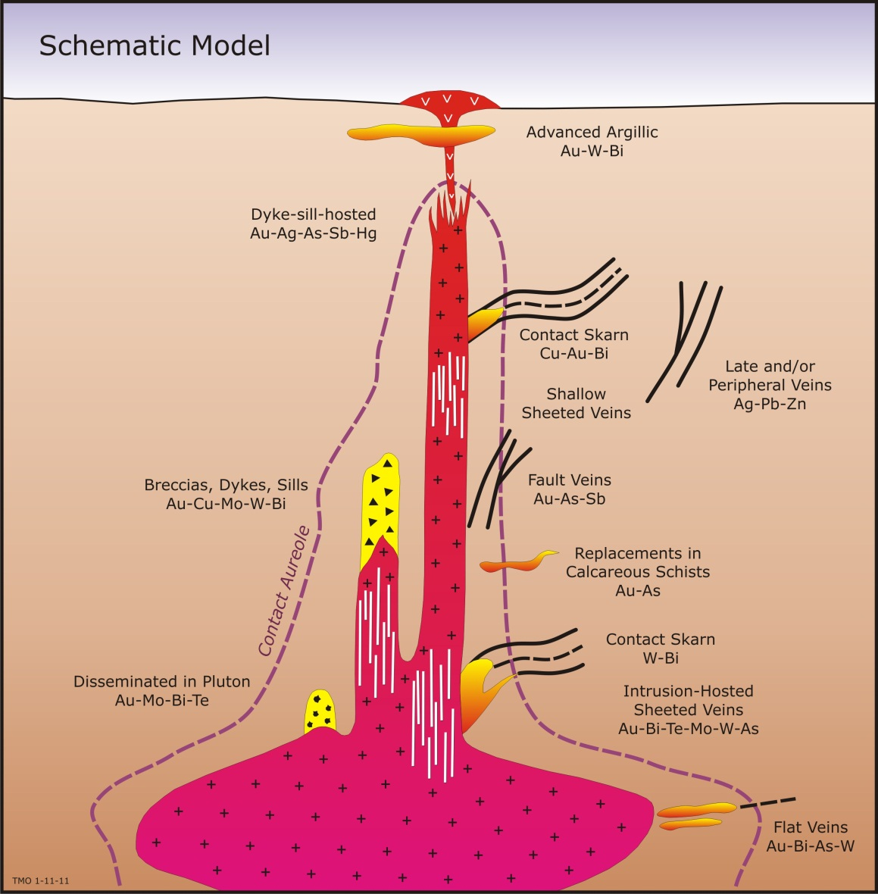
14
Intrusion Related Gold Model
New deposit model to research and apply
Pipe like geometry
Has essential gold
Associated with pathfinder elements - bismuth, tin, tungsten, arsenic, copper, lead, zinc, silver, molybdenum
Sheeted vein systems; commonly in or above the intrusion roof

Slide 15
15
Intrusion Related Gold Examples
Alaska:
  Donlin Creek – 23 million ozs gold (10th largest global Au deposit)
  Livengood – 20.6 million ozs gold (31st largest)
  Pogo – 4.8 million ozs gold
  Fort Knox – 4.1 million ozs gold
Yukon:
  Dublin Gulch – 3 million ozs gold
  Red Mountain – 2 million ozs gold
  Brewery Creek – 1.2 million ozs gold
Queensland:
  Kidston – 5 million ozs gold
  Mt Leyshon – 3.2 million ozs gold
Sources: Baker et al. Economic Geology 2006; Thompson et al. Min Deposita 1999; SEG News Oct 12; websites of International Tower Hill Mines; Golden Predator; Victoria Gold; Resolute Mining.

Slide 16
16
Magnetic Signature – Yukon
Red
Mountain
Project
Brewery Creek Mine
10km
= These are all IRG mineralised systems including two +1Moz Au
Notes:
Selwyn Basin. All mag anomalies are known IRG mineralised systems inc Brewery Creek (1.2 Moz) and Red Mountain (2 Moz). Dublin Gulch (3 Moz) off map to east.

Slide 17
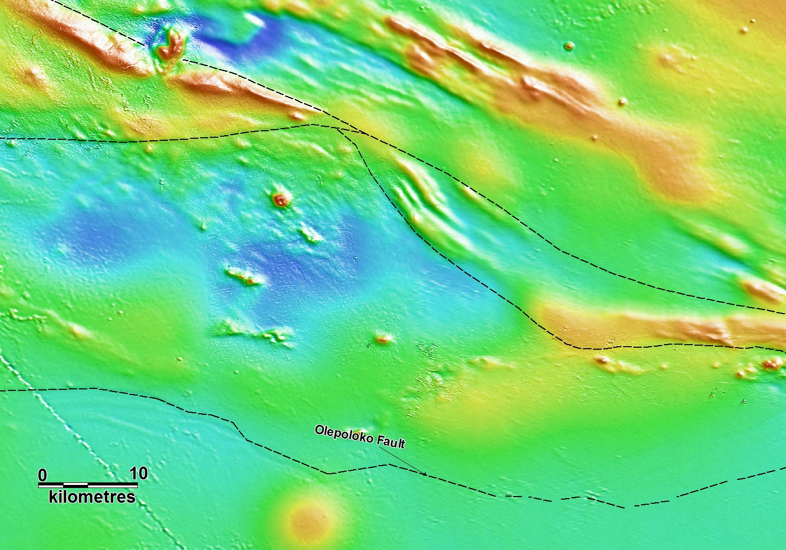
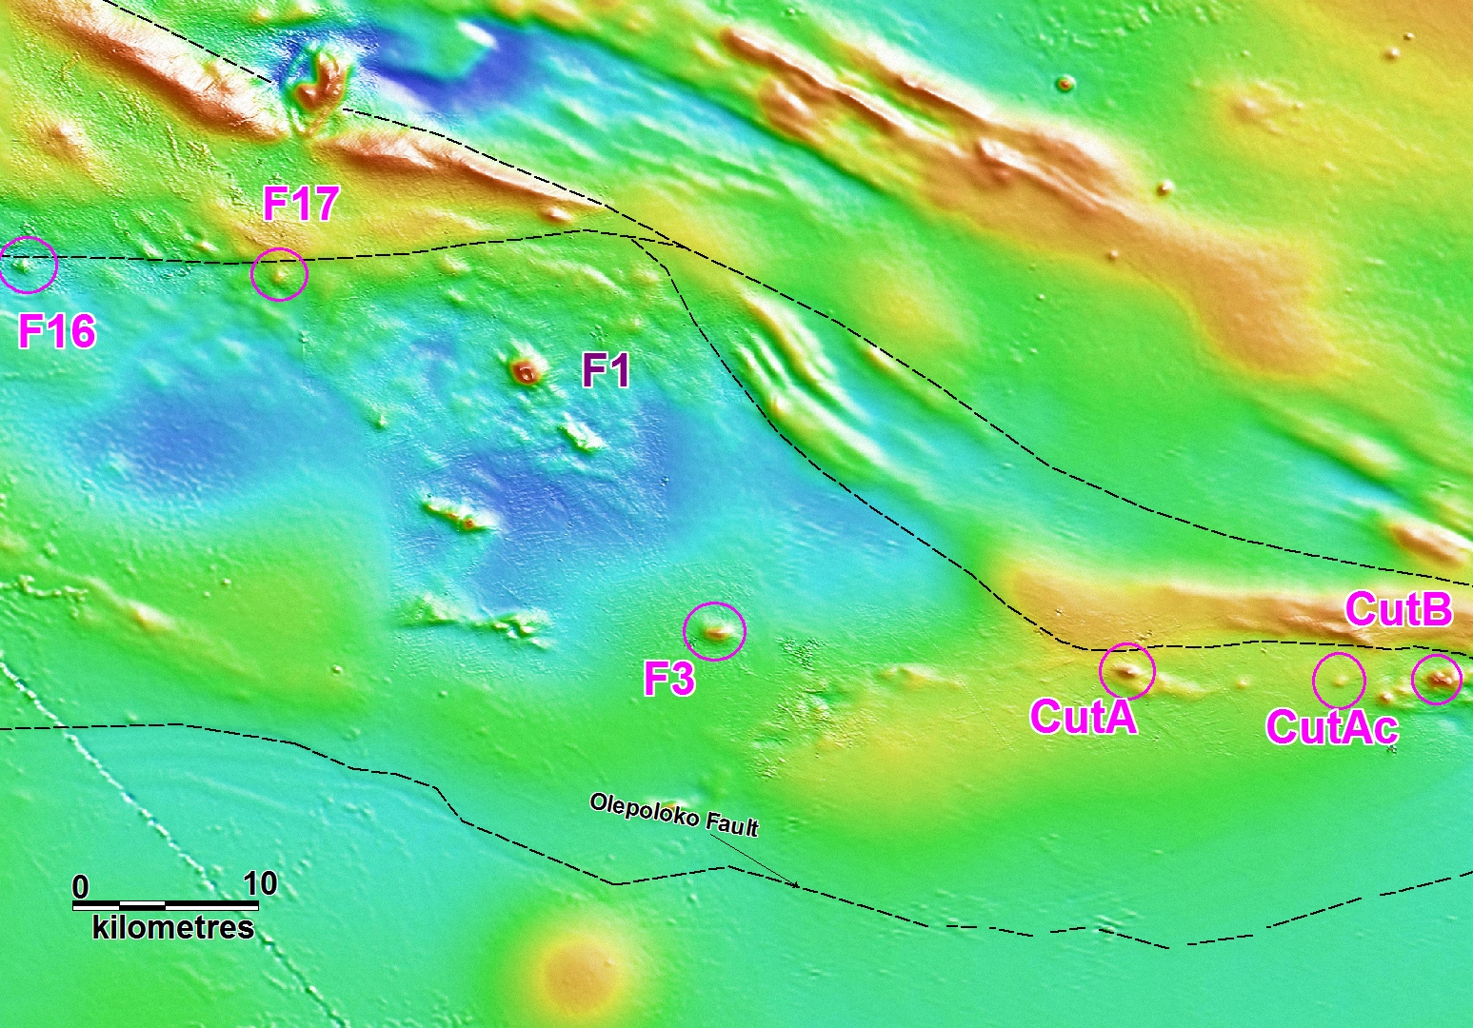
17
Magnetic signature - Cuttaburra IRG Field
and these are IRGs too!
Notes:
CutA – 1m at 3.7 (449m (Cu eq = 4%, 6 g/tAu eq), or 3.3m at 1.5 Au, 0.1% Cu, 11 Ag. Cut B 0.7m at 411m (8 g/t Au eq)
Number of holes – 13 total

Slide 18
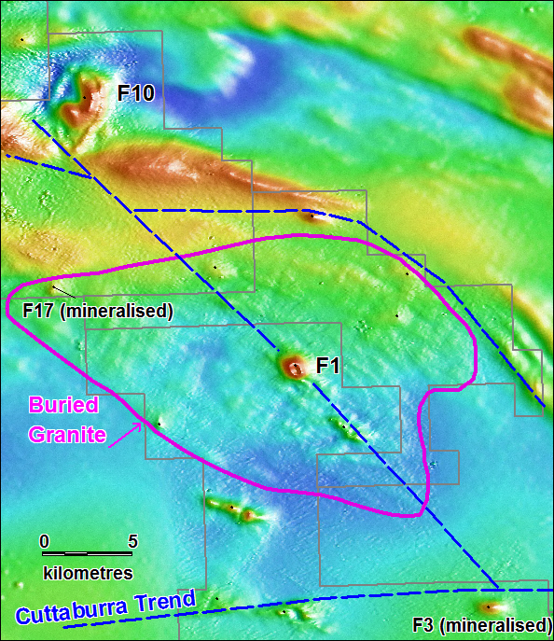
18
F1 anomaly
New deposit model – intrusion related gold (IRG)
Possible large buried granite below F1
Peripheral anomalies F3, F17 are mineralised
F1 – Drilled – May 2013
  Large (2km), ring-type magnetic anomaly
  Central position to buried intrusion
  Linear alignment with F3 and F10
  Shallow cover ~100m

Slide 19
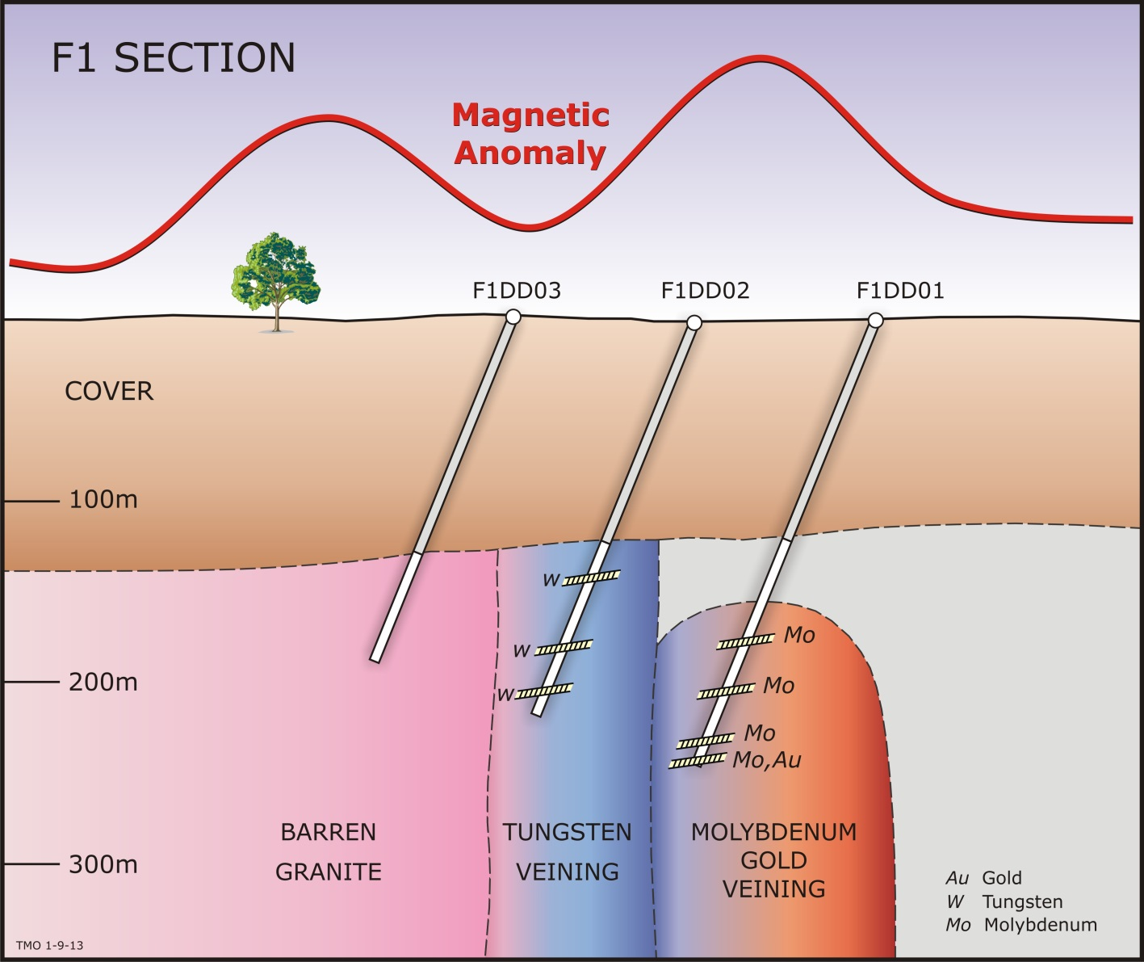
19
F1 prospect section
Quartz-carbonate stacked vein systems in granite with pyrrhotite, pyrite, sphalerite and galena
Spot highs over 1m –
  Mo 0.2%,
  W 0.3%,
  Au 0.24 g/t,
  Pb 0.1%, Zn 0.1%,
  Ag 13 g/t, As 1%

Slide 20
20
Thomson IRGs – research in progress
F1 – zoning pattern identified: barren -> W -> Mo -> Mo+Au
Prospective zone to the east at margin of late intrusion
Or elsewhere on the broader anomaly (target SE or NW culminations?), or at depth
Hole is prepared for downhole geophysics
EM did not work at Cuttaburra; 3 component downhole magnetometer may identify the source of the magnetic anomaly (this has been an issue at Cuttaburra – remanence complication)

Slide 21
Features of IRG systems
21
Tectonic Setting – Inboard of arc
Host – deformed sediments intruded by reduced, peraluminous I-type granodiorite-tonalite
Note – no Porphyry-type deposits in same belt
Sheeted and stockwork quartz-carbonate veins
Pervasive disseminated pyrrhotite and scheelite (in granite)
Vein sulphides - pyrrhotite, pyrite, arsenopyite, sphalerite, galena, chalcopyrite
Metal suite – Au-Mo-W-Sn-Cu-Pb-Zn-As-Bi
Alteration - silica – muscovite - Fe carbonate – (Na, K feldspar?)
Regional tungsten anomaly
All 8 anomalies between Olepoloko and Tongo Faults share these characteristics with known Intrusive–Related Gold systems

Slide 22
22
Disclaimer
The information contained in this presentation has been prepared by Thomson Resources Limited (TMZ).
This presentation and the information contained in this notice is not a recommendation, offer or invitation by any person to sell or apply for securities in TMZ in any jurisdiction and none of this presentation document or its contents shall form the basis of any contract or commitment.
This presentation is not a disclosure document under Australian law or under any other law. It is for information purposes only. Accordingly, this presentation document neither purports to be exhaustive nor contain all of the information which a prospective investor or you may require to make an investment decision and it does not contain all of the information which would otherwise be required by Australian law or any other law to be disclosed in a prospectus. Any invitation or offer to apply, buy or subscribe for securities in TMZ will only be made or extended through a disclosure document lodged with the Australian Securities and Investments Commission in the event that any such invitation or offer proceeds.
This presentation has been prepared in good faith, but no representation or warranty, express or implied, is made as to the fairness, accuracy, completeness, correctness, reliability or adequacy of any statements, estimates, opinions or other information, or the reasonableness of any assumption or other statement, contained in the presentation (any of which may change without notice). To the maximum extent permitted by law, TMZ and its directors, officers, partners, employees, advisers and agents and any other person involved in the preparation of the presentation disclaim all liability and responsibility (including without limitation any liability arising from fault or negligence) for any direct or indirect loss or damage which may arise or be suffered through use or reliance on anything contained in, or omitted from, the presentation.
No representation or warranty, express or implied, is given as to the fairness, accuracy, completeness, likelihood of achievement or reasonableness of any forecasts, prospective statements or returns contained in the presentation. Such forecasts, prospective statement or returns are by their nature subject to significant uncertainties and contingencies. You should make your own independent assessment of the information and take your own independent professional advice in relation to the information and any action taken on the basis of the information.
Any such forecast, prospective statement or return contained in the presentation has been based on current expectations about future events and is subject to risks, uncertainties and assumptions that could cause actual results to differ materially from the expectations described.
TMZ does not have any responsibility or obligation to inform you of any matter arising or coming to their notice, after the date of this presentation document, which may affect any matter referred to in the presentation. You must not rely on the presentation provided but make your own independent assessment of the presentation and seek and rely upon your own independent taxation, legal, financial or other professional advice in relation to the presentation. The presentation is not intended to constitute financial product advice and does not take into account your investment objectives, taxation situation, financial situation or needs.
The distribution of this presentation in other jurisdictions including (without limitation) the United States, Canada and Japan (or to any resident thereof) may be restricted by law and therefore persons into whose possession this presentation comes should inform themselves of and observe any such restrictions. Any failure to comply with these restrictions may constitute a violation of the securities laws of any such jurisdiction.
The Shares have not been, and will not be, registered under the US Securities Act or under any of the relevant securities laws of any state of the United States or of Canada or Japan. Accordingly, unless an exemption under such act or laws is applicable, TMZ Shares may not be offered, sold or delivered directly or indirectly in or into the United States, Canada or Japan.
Competent Person Statement
The information in this report that relates to Exploration Results, Mineral Resources or Ore Reserves is based on information compiled by Eoin Rothery, (MSc), who is a member of the Australian Institute of Geoscientists. Mr Rothery is a full time employee of Thomson Resources Ltd. Mr Rothery has sufficient experience which is relevant to the style of mineralisation and type of deposit under consideration and to the activity which he is undertaking to qualify as a Competent Person as defined in the 2004 Edition of the “Australasian Code for Reporting of Exploration Results, Mineral Resources and Ore Reserves”. Mr Rothery consents to the inclusion in the report of the matters based on his information in the form and context in which it appears.

